Slide 1

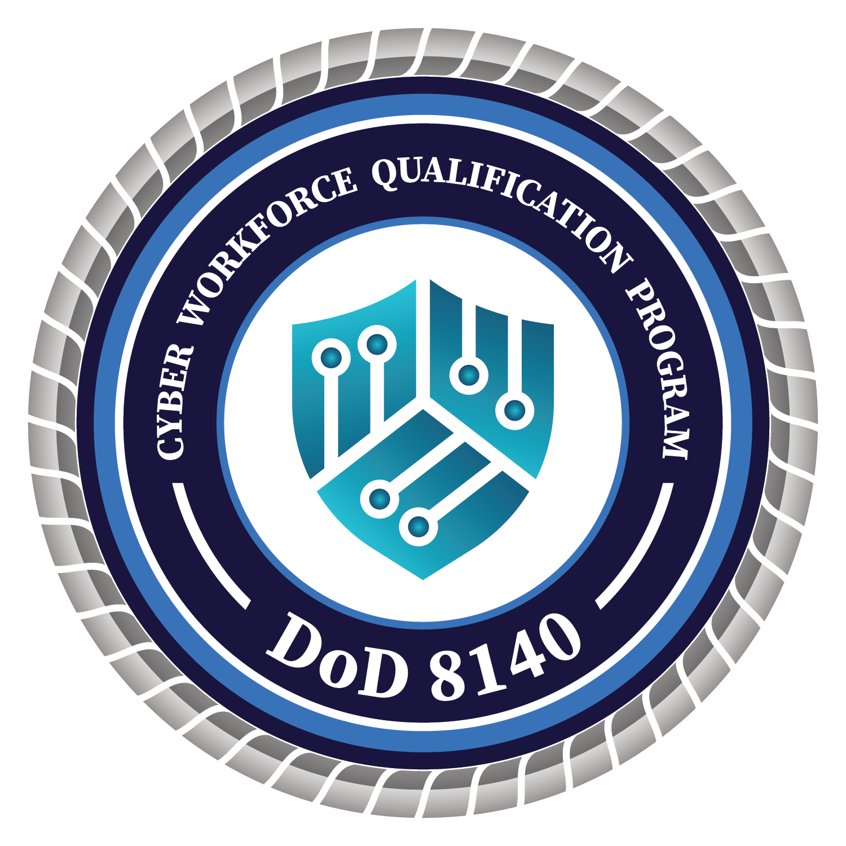
DoD 8140 Experience Qualification Process
For Foundational Qualification
DCWF Applicability:
CS, IT, Cyber Enabler Work Roles
DoD 8140 Proficiency Level Applicability:
Basic, Intermediate, and Advanced
DoD Reference: DoDM 8140.03
EXECUTIVE SUMMARY:
The DoD 8140 Experience Qualification Process (EQP) provides a method to validate and document specific, relevant knowledge and skills attained through performing the tasks of DoD Cyber Workforce Framework (DCWF) work role(s) in a DoD environment by assessing a CWF member’s cyber experience to meet the DoD 8140 foundational qualification. This conditional alternative option mitigates the requirement to expend additional resources on DoD civilian employees and military service members (i.e., encumbered personnel) who have successfully demonstrated their ability to perform their assigned work roles at the prescribed proficiency level associated with their current/incumbent position.
DOD 8140 EXPERIENCE MATERIALS:
Implementation Guide
Evaluation Worksheet
Experience Certificate
DOD 8140 EXPERIENCE QUALIFICATION FORMAL EXPIRATION DATES:
DCWF Cybersecurity (CS) Workforce Element:
Anticipated for CY2027
DCWF Information Technology (IT) & Cyber Enablers Workforce Elements:
Anticipated for CY2028

